Slide 1
Ammonia Refrigeration General Duty Clause (GDC) Pilot Project
Janet Bowen
EPA Region 1
U.S. EPA Region 1
October 23, 2018
Notes:
Elise

Slide 2
National Enforcement Initiative (NEI): Reducing Risks of Accidental Releases at Industrial and Chemical Facilities
October 2016 - September 2019
Greater emphasis on outreach and enforcement
Ammonia refrigeration chosen as one of the priority sectors
www.epa.gov/enforcement/national-enforcement-initiative-reducing-risks-accidental-releases-industrial-and
Notes:
Elise
The goal of this initiative is to reduce the risk to human health and the environment by preventing chemical accidents. A successful initiative would reduce communities’ risk by having regulated facilities and industry associations work to improve safety; increasing compliance with RMP and GDC requirements; and promoting coordination and communication with state and local responders and communities.

Slide 3
Background on CAA Section 112(r)
General Duty Clause (GDC)
Risk Management Plan (RMP) Requirements

Slide 4
Quick Comparison of CAA Section 112(r): GDC and RMP
RMP Rule
General Duty Clause
Stationary sources
that manage extremely hazardous substances must:
Identify hazards
Design and maintain a safe facility so as to prevent releases
Minimize consequences of releases that do occur
Stationary sources
With listed chemicals
Over certain thresholds in a process
Must submit RMP plan and
Follow detailed regulations that flesh out the general duties
Notes:
Section 112(r) of the Clean Air Act essentially has two enforceable ”prongs.” The first is the General Duty Clause, found in Section 112(r)(1). The General Duty Clause requires three things of stationary sources that produce, process, handle, or store extremely hazardous substances:
To identify the hazards that might result from the release of the substance, using appropriate hazard assessment techniques
To design and maintain a safe facility so as to prevent releases and
To minimize the consequences of accidental releases that do occur.
These requirements apply both to the owners and operators of the stationary source. Congress specifically included anhydrous ammonia in its initial list of extremely hazardous substances.
Also, under Clean Air Act Section 112(r)(7), Congress authorized EPA to promulgate chemical accident prevention regulations for a certain stationary sources. This second enforceable ”prong” of Section 112(r) is commonly referred to as the Risk Management Planning (RMP) Rule, found at 40 C.F.R. Part 68. For ammonia refrigeration systems, the RMP Rule applies to systems that have more than 10,000 pounds of anhydrous ammonia.
The RMP Rule requires submittal of a Risk Management Plan to EPA and fleshes out the three general duties discussed above with more detailed regulations. If you have more than 10,000 pounds of ammonia in one system (the legal term is “process”) and have not yet submitted an RMP plan, you need much more training than this overview will provide. For more training on the RMP Rule go to [link to EPA web site and Region 7’s RMP training].

Slide 5
General Duty Clause Pilot
Notes:
EPA is planning to launch the Compliance Assurance and Enforcement Focus to improve safety at facilities with smaller ammonia refrigeration systems (over 1000 pounds and less than 10,000 pounds). After a public notice period informing the regulated community about the program, EPA plans to send brief, targeted Information Requests to selected facilities that it has reason to believe may be out of compliance. Facilities will be required to respond to EPA answering four questions about their ammonia refrigeration systems, including whether a process hazard review has been performed. If a facility has not performed the required hazard review, EPA will inform the facility that it has violated the first duty of the General Duty Clause, and offer a one-count settlement with a requirement to perform a hazard review, meet with emergency responders, and pay a small penalty.

Slide 6
Traditional General Duty Clause Enforcement
Many of Region 1’s GDC inspections have found serious deficiencies.
Number of these smaller refrigeration facilities overwhelms our inspection resources
Enforcement cases usually involve 2-3 GDC counts, which are very detailed and time consuming
Need more efficient way to improve safety
If owners had a better understanding of the hazards, they might fix some of the problems on their own

Slide 7
General Duty Clause Pilot
3 GDC Statutory Duties
“Identify hazards which may result from such releases using appropriate hazard assessment techniques”
Design and maintain safe facility…. to prevent releases
Minimize consequences of accidental releases which do occur
Purpose: Improve compliance at GDC facilities without need for inspections.
Steps:
Identify facilities
Send public notice
Issue info. request to determine if company has identified hazards (GDC Duty #1).
If not, offer a $5,000 ESA, requiring company to (a) conduct hazard review with expert help, and (b) meet with emergency responders.

Slide 8
GDC Pilot: Information Request
Information request has just four “fill in the blank” questions
* Does your facility have a refrigeration system that uses ammonia?
* What is the inventory?
* Has a process hazard review been conducted?
* Any significant releases in the last 5 years?
Notes:
Is “Significant release” defined??

Slide 9
GDC Pilot: Settlement Offer
Offer an expedited settlement if facility has not conducted a process hazard review.
Settlement:
Only one GDC count (failure to identify hazards)
$5,000 penalty
Commit to:
Conduct process hazard review with an expert’s help
Meet with emergency responders and file any missing EPCRA forms
Send short statement re. safety improvement plans

Slide 10
Impact of GDC Pilot
Resource limitations mean:
No EPA review of process hazard reviews (not even submitted)
Settlement only resolves one GDC count
May not reach entire ammonia refrigeration universe
But Pilot should:
Reach more facilities
Raise companies’ awareness of hazards posed by their systems
Improve GDC and EPCRA compliance
Increase safety of communities and emergency responders

Slide 11
How GDC Pilot Fits in with Region 1’s Integrated Strategy for Safety
at Ammonia Refrigeration Facilities
FY’17 and ‘18
Compliance Assistance Outreach to approx. 1,750 people
6 ASTI/IIAR workshops
2 table top exercises
EPCRA webinar
EPCRA article for ice rinks
Informal Enforcement
Notices of Potential Violations to convey inspection reports
NOVs -no further action
Formal Enforcement
Criminal
Judicial
Admin. settlements
Expedited Settlement Agreements
Admin. compliance orders
Notes:
Ammonia assistance related work summary
EPA New England’s Chemical Accident Prevention Program helps facilities that use hazardous chemicals comply with environmental and storage safety rules. There are many more facilities that must comply with these rules than EPA resources can inspect, so EPA has been using a strategic approach of enforcement and assistance to promote safe practices for storing and using hazardous chemicals. The Region has focused work on ammonia refrigeration facilities in support of the National Enforcement Initiative: Reducing Risks of Accidental Releases at Industrial and Chemical Facilities. In 2017, there were 8 reported ammonia releases at New England ammonia refrigeration facilities. As of July 2018, there have been 5 reported ammonia releases at refrigeration facilities.
Ammonia refrigeration work done by EPA Region 1 includes: state ammonia safety trainings, ammonia table-top exercises, ammonia presentations, a chemical accident prevention video, ammonia group email blasts; analysis of EPCRA tier 2 data for ammonia refrigeration facilities; EPCRA in-person workshops and an EPCRA webinar; launch of the Compliance Assurance and Enforcement Focus to improve safety at facilities with smaller ammonia refrigeration systems; and focused assistance to New England ice rinks on EPCRA tier 2 reporting.
Starting in January 2017, EPA sponsored ASTI/IIAR ammonia safety trainings in 5 New England states. The last training will be held in Connecticut in September 2018. Most trainings lasted two days, with one day geared toward emergency response responders and the other focused on IIAR standards. There were more than 280 unique attendees for the five state trainings. Maine sponsored one more ammonia safety training with an EPA speaker that had an additional 47 attendees. EPA also gave an ammonia presentation at the Boston Bar Association.
In November 2017, EPA sponsored two tabletop exercise events in Maine and Massachusetts, each focused on appropriate emergency response to a large-scale ammonia release. The purpose of the exercise was to examine the necessary information sharing and coordination efforts required between private sector companies and responder organizations to minimize the impact on human health and the environment. Seventy-two participants were involved in the exercises.
EPA released a Chemical Accident Prevention video in May 2018. This video includes information on Section 112r General Duty Clause and footage from some ammonia refrigeration facilities in New England: https://www.youtube.com/watch?v=hLA6EYa7tMg
EPA developed an ammonia email group of over 100 staff, including New England ammonia refrigeration contractors, suppliers and trade associations, to keep the regulated community informed of EPA ammonia refrigeration efforts. This group was notified about upcoming EPA ammonia trainings, EPCRA trainings and the EPCRA webinar, EPA ammonia enforcement press releases and EPA resources (e.g. chemical accident prevention video, key safety measures, and compliance assistance tools publication). EPA encouraged recipients to share these emails with their ammonia refrigeration clients. As an example of the reach of these mailings, the first email advertised the January 2017 MA ammonia safety training, which lead one ammonia contractor to register 15 contacts, including 3 staff and 9 clients. In another example, EPA sent the group a link to the Chemical Accident Prevention video. Viewership immediately spiked, and within one month, the total number of views increased from about 120 views to over 250 views.
EPA is working to increase EPCRA tier 2 reporting within the Region, especially with ammonia refrigeration facilities. In 2017, EPA sponsored 7 in-person workshops in 4 states (CT, NH, RI and VT) with over 600 registered attendees. Maine conducted its own EPCRA workshops. In addition, in January 2018, EPA held a webinar focused on EPCRA reporting that was attended by 523 people. Follow-up information on EPCRA reporting was sent to all 712 who registered. The workshops and webinar used ammonia and the ice skating sector as an example.
EPA created a list of potential ammonia refrigeration facilities in New England. As part of the list, EPA tracks any refrigeration facility that has reported ammonia on an EPCRA Tier 2 form in the past, as well as facilities that have had ammonia releases. In FY2018, EPA compared multiple years of EPCRA tier 2 data and flagged any facility that was not reporting ammonia in the current year. Calls were made to the fire department to try and assess if the facility was still operational and using ammonia. After the calls to the fire departments, states received about six EPCRA tier 2 forms late from facilities. EPA is planning to use some of these facilities as Phase 1 of our General Duty Clause pilot for our Compliance Assurance and Enforcement Focus.

Slide 12
EPA’s work with Ice rinks

Slide 13
Ice Rink work
Universe identification
– about 310 rinks in New England
Work with Ice rink associations
EPCRA Tier 2 article for rinks (December 2017)
EPCRA workshops and webinar (January 2018)
- included ice rink example
Map of ammonia ice rinks based on EPCRA Tier 2
Measured increased EPCRA reporting and ammonia facilities
Notes:
Assumption
With the phase out of R22 that many rinks may consider or switch to ammonia so we wanted to work with the sector. In FY2018, EPA also targeted assistance, education, training, and outreach to approximately 300 ice rinks in New England with the goal of increasing EPCRA Tier II reporting for facilities using ammonia or other regulated chemicals. Assistance activities included partnering with local industrial trade associations to publish an article on EPCRA Tier 2 reporting, direct outreach to rinks throughout the year to publicize training and assistance resources, and delivering a web-based training on EPCRA Tier 2 reporting.
Rink associations
NEISMA (Northeast Ice Skating Managers Association – northeast based) about 300 members
US Ice rinks (National) about 1500 members
Map of rinks
- 78 rinks reporting ammonia (2016 data for CT and RI /2017 data for MA, NH, ME and VT)
- 16 rinks probably have ammonia
- majority of rinks unknown about 175
Increase in reporting
Based on available 2017 data for 4 states (MA, ME, NH and VT), there was a 16.3% increase in EPCRA Tier II forms filed at ice rink facilities and a 12.5% increase in facilities reporting ammonia from our baseline of 2015.

Slide 14
Available Resources for Ammonia Refrigeration Facilities

Slide 15
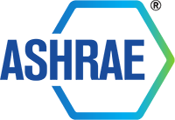
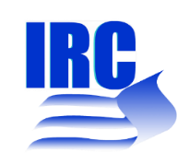
Online Resource: Compliance Assistance Tools and Resources for Ammonia Refrigeration Facilities
Contains industry-specific information for the implementation of the Chemical Accident Risk Reduction (CARR) National Enforcement Initiative (NEI).
Provides lists and descriptions of tools and resources broken out by the following types: EPA, EPA Partnerships, and Trade Associations
www.epa.gov/sites/production/files/2017-11/documents
/complianceassistance-ammoniarefrigerationsector0617.pdf

Slide 16
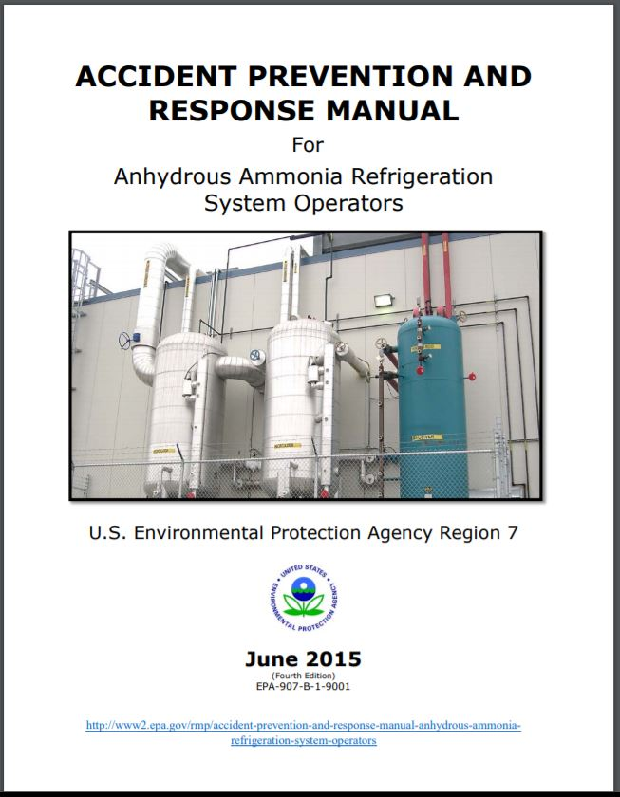
Ammonia Refrigeration Manual
ACCIDENT PREVENTION AND RESPONSE MANUAL
For Anhydrous Ammonia Refrigeration
System Operators
June 2015
(Fourth Edition)
EPA-907-B-1-9001
www.epa.gov/rmp/accident-prevention-and-response-manual-anhydrous-ammonia-refrigeration-system-operators
Notes:
ACCIDENT PREVENTION AND RESPONSE MANUAL
For Anhydrous Ammonia Refrigeration
System Operators
June 2015
(Fourth Edition)
EPA-907-B-1-9001
This manual summarizes the requirements of environmental and safety laws for anhydrous ammonia refrigeration system operators. A list of the federal laws and regulations related to process safety, accident prevention, emergency planning, and release reporting may be found in Appendix C
Link to: https://www.epa.gov/sites/production/files/2015-05/documents/accident_prevention_ammonia_refrigeration_5-20-15.pdf

Slide 17
Key Safety Standards Document
Brief list
Not an all inclusive
Many potentially important RAGAGEP are not on the list
EPA inspectors/CRO’s will be looking at these when working with a facility
Developed and mutually agreed upon with IIAR
www.epa.gov/sites/production/files/2018-05/documents/listofkeymeasurements.pdf
Notes:
As part of the Chemical Accident Risk Reduction national enforcement initiative, EPA developed the following key safety measures in coordination with the International Institute of Ammonia Refrigeration. They are measures that EPA and IIAR agreed should be in place, regardless of an ammonia refrigeration system’s age or size, for the system to meet the requirements of 40 C.F.R. Part 68 or the General Duty Clause. This is not intended to be a complete list of important safety measures but rather a subset of easily verifiable items that could help facilities prevent ammonia releases and prepare for any releases that do occur. These safety measures should be reviewed during inspections and included as injunctive relief/compliance measures in all settlements where applicable. The second list contains other important safety measures that should be reviewed during inspections and incorporated into settlements if at all possible. This second list also was developed with IIAR’s input.
Also, here is a link to a checklist that some EPA inspectors use during refrigeration inspections to help them assess the condition of systems. It reflects some of the conditions that EPA sees frequently and may be helpful to you because it references many industry standards and guidance. [add link to ERG’s checklist]. The International Institute of Ammonia Refrigeration (IIAR) also publishes checklists to help facilities inspect their systems. www.iiar.org.

Slide 18
Chemical Accident Prevention Video
EPA New England’s Chemical Accident Prevention Program helps facilities that use dangerous chemicals comply with environmental and storage safety rules. EPA has been using a strategic approach of enforcement and assistance to promote safe practices for storing and using hazardous chemicals.
https://www.youtube.com/watch?v=hLA6EYa7tMg
Notes:
EPA New England’s Chemical Accident Prevention Program helps facilities that use dangerous chemicals comply with environmental and storage safety rules. There are many more facilities that must comply with these rules than EPA resources can inspect so EPA has been using a strategic approach of enforcement and assistance to promote safe practices for storing and using hazardous chemicals
Includes footage from ammonia refrigeration facility

Slide 19
CAMEO Chemicals
Find response information for thousands of hazardous materials, including fire and explosion hazards, health hazards, firefighting techniques, cleanup procedures, protective clothing, and chemical properties.
Information about EPA, OSHA and Homeland Security regulations is available on each chemical page.
https://cameochemicals.noaa.gov/

Slide 20
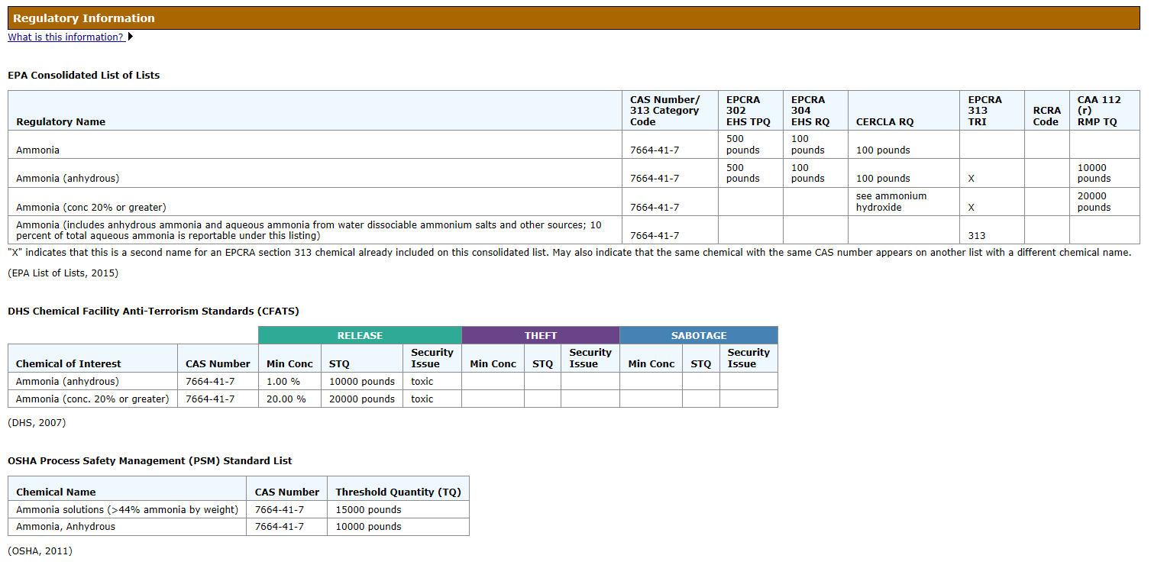
Regulatory page for Ammonia Cameo Chemicals
Notes:
Shows how EPA regulates ammonia and thresholds for different amounts
Shows other regulatory agencies thresholds (OSHA and Homeland security)
OSHA also has standards below 10,000 pounds like EPA

Slide 21
EPA eDisclosure
Web based “eDisclosure” portal launched December 2015
Allows entities to promptly disclose violations and submit compliance certification under EPA’s Audit policy
eDisclosure: https://www.epa.gov/compliance/epas-edisclosure
EPA Audit Policy: https://www.epa.gov/compliance/epas-audit-policy

Slide 22
Questions?
Janet Bowen, EPA Region 1
Bowen.Janet@epa.gov
617-918-1795
Len Wallace, EPA Region 1
Wallace.Len@epa.gov
617-918-1835

